Slide 1
Connecting Atomistic Simulations and Experiments Using Virtual Diffraction
Shawn P. Coleman
Lightweight and Specialty Metals Branch, ARL

Slide 2
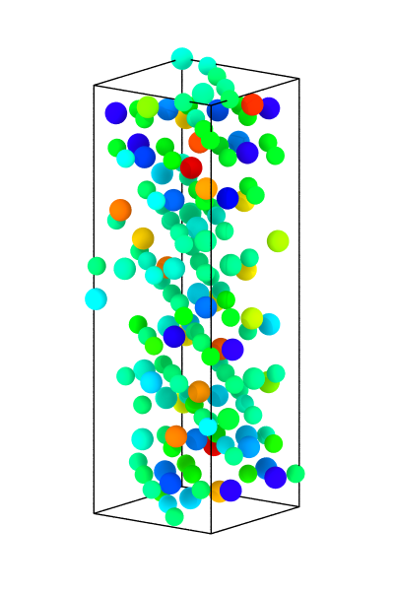
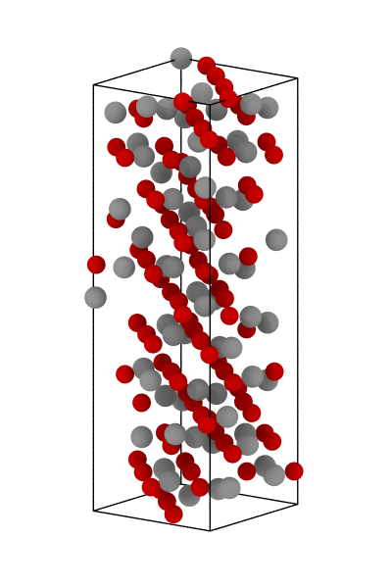
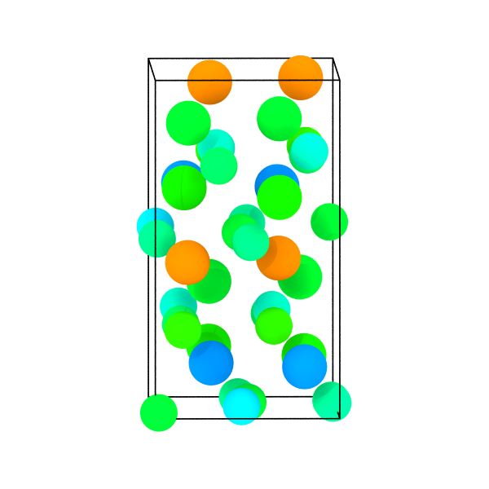
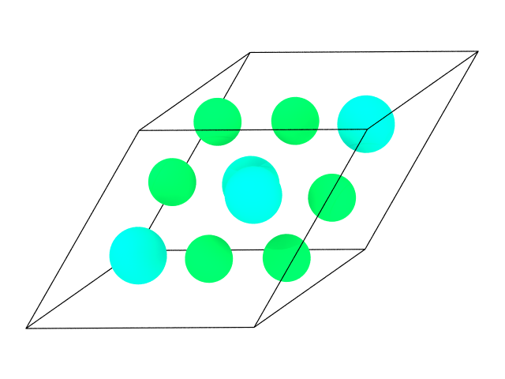
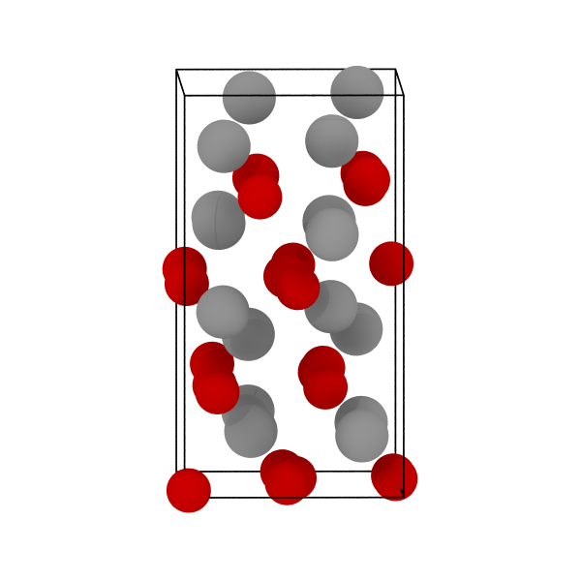
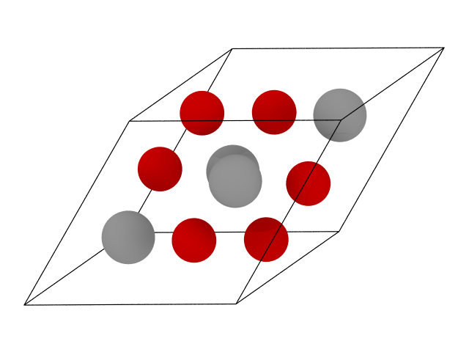
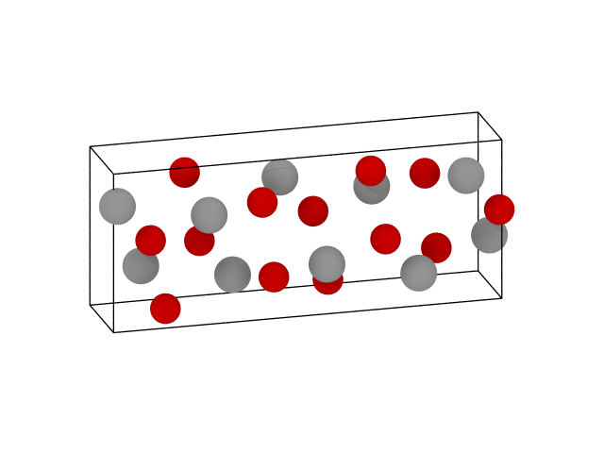
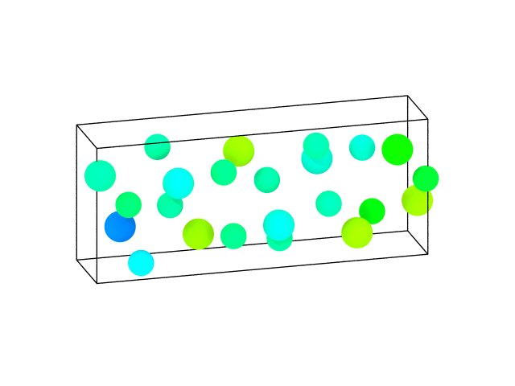
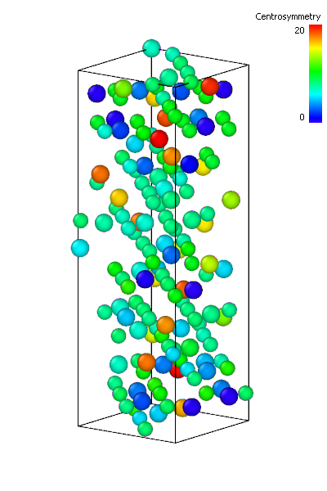
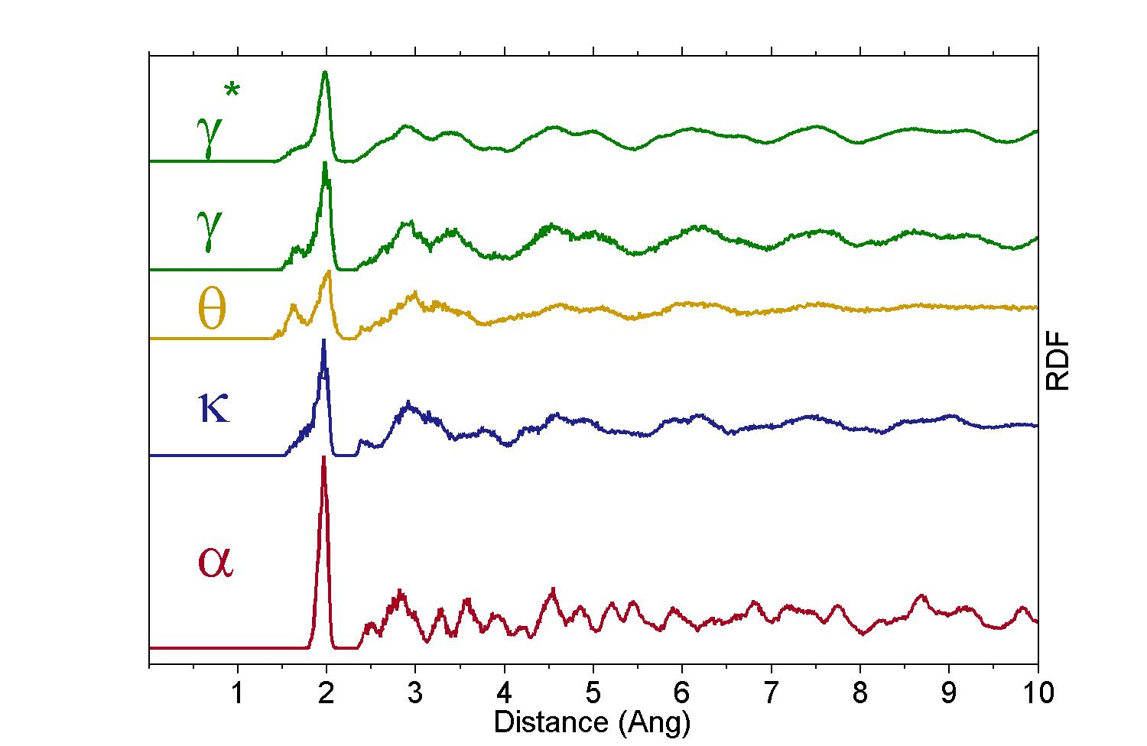
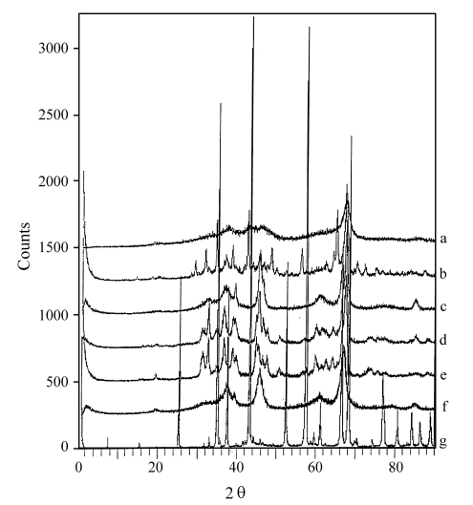
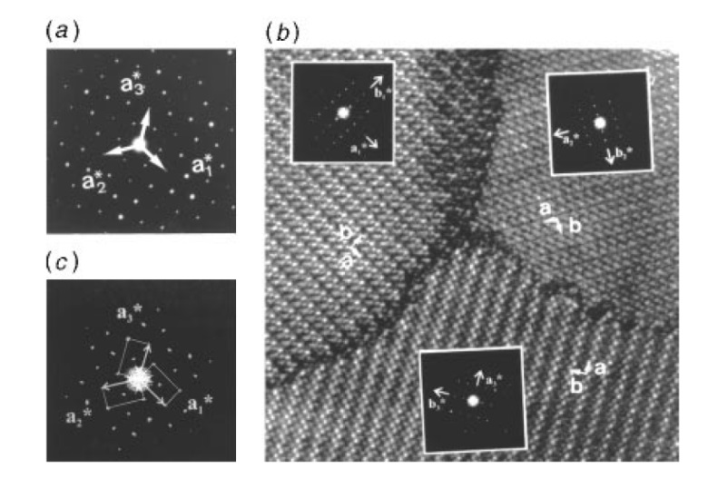
Motivation
Alumina Polymorphs
Identification of complex material (non-cubic) phases and phenomena within atomistic simulations is difficult.
Experimental x-ray and electron diffraction routinely used for characterization of (complex) materials.
Fundamental disconnect between simulation and experimental characterization tools.
γ
α
κ
θ
Centrosymmetry(Å²)
0
5
10
15
20
Radial Distribution Functions
z
XRD
of Alumina Phases
SAED and HRTEM
of 120° twins in κ-Al₂O₃
Virtual diffraction offers a bridge to directly connect atomistic simulations with experimental characterization.
Santos et al. (2000)
Ollivier et al. (1997)

Slide 3
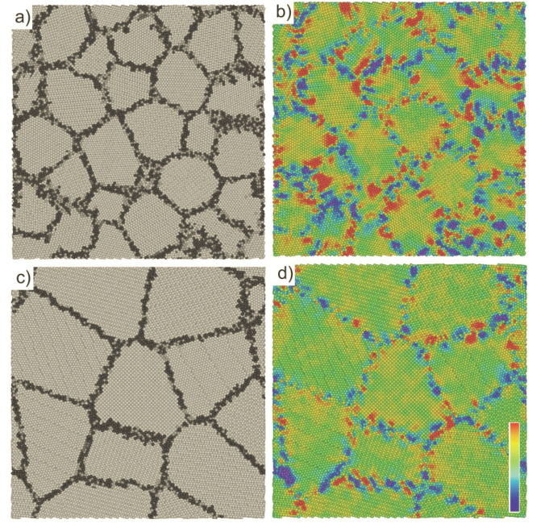
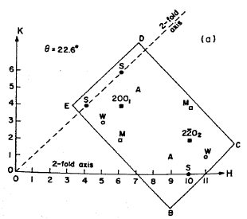
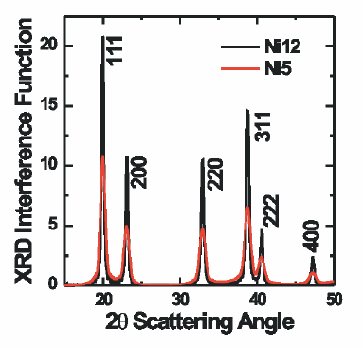
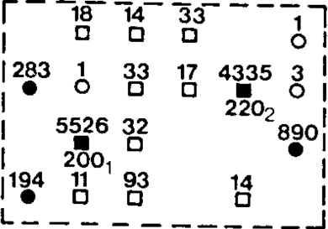
Background
Previous studies have paved the way to the current virtual diffraction algorithm and implementation:
Twist boundaries in Au
Nanocrystaline Ni
(Bristowe and Sass, 1980)
Required knowledge of crystal structure.
Produced only XRD patterns
Limited Implementation
(Derlet et al, 2005)
Experimentally Observed
5 nm
12 nm
D
C
Debye Scattering Equation
Computed Structure Factor
E
B

Slide 4
Virtual Diffraction from 10,000 ft
Create a mesh of reciprocal space
3D rectilinear mesh but with spherical boundary conditions.
Ultrafine resolution eliminates any need for prior knowledge of the crystal structure.
Compute diffraction intensities at each point on the reciprocal space mesh using the structure factor equations
Compute structure factor for all atoms within the simulation.
3. Analysis and visualization of diffraction intensities to produce
X-ray diffraction line profiles (XRD)
Selected area electron diffraction patterns (SAED)
Implemented into the LAMMPS MD code

Slide 5
Diffraction Intensity Computation
At each reciprocal lattice node the diffraction intensity is calculated utilizing the structure factor equation,
Sampled Reciprocal Space
= Lorentz-Polarization Factor (only XRD)
= Structure Facture
= Reciprocal Lattice Point (Relp)
~10-100M
Relp
Structure Factor:
~1-10M Atoms
All atoms are sampled at each reciprocal point.
= Number of Atoms in Simulation
= Atomic Scattering Factor
= Atom Position

Slide 6
Computational Optimization
MPI parallelization over real space
LAMMPS - Spatial decomposition of atoms parallelized over MPI processes
Each process must have a copy of
the reciprocal space mesh
0
4
CPU
5
1
~10-100M Relp
~1-50M Atoms
2
6
Very Memory Intensive
3
7

Slide 7
Multilevel Parallelization
OpenMP parallelization of reciprocal space
Reduce the number of MPI processes per node
Decompose reciprocal space with OpenMP
MPI Parallelization of atoms across
multiple CPU nodes
0
0
OpenMP threads
OpenMP threads
0
OpenMP threads
0
OpenMP threads
0
4
0
4
0
4
0
4
CPU
1
5
1
5
1
5
~10-100M Relp
1
5
~1-50M Atoms
2
6
2
6
2
6
2
6
Preventative for MD computations
3
7
3
7
3
7
3
7

Slide 8
Heterogeneous Computing
Using MIC accelerators in addition to CPU
Offloading a percentage of the computation for concurrent computation of intensity.
0
4
0
4
0-3
4-7
CPU
5
MIC
1
1
5
8-11
12-15
2
6
2
6
16-19
20-23
3
7
3
7
24-27
28-31

Slide 9
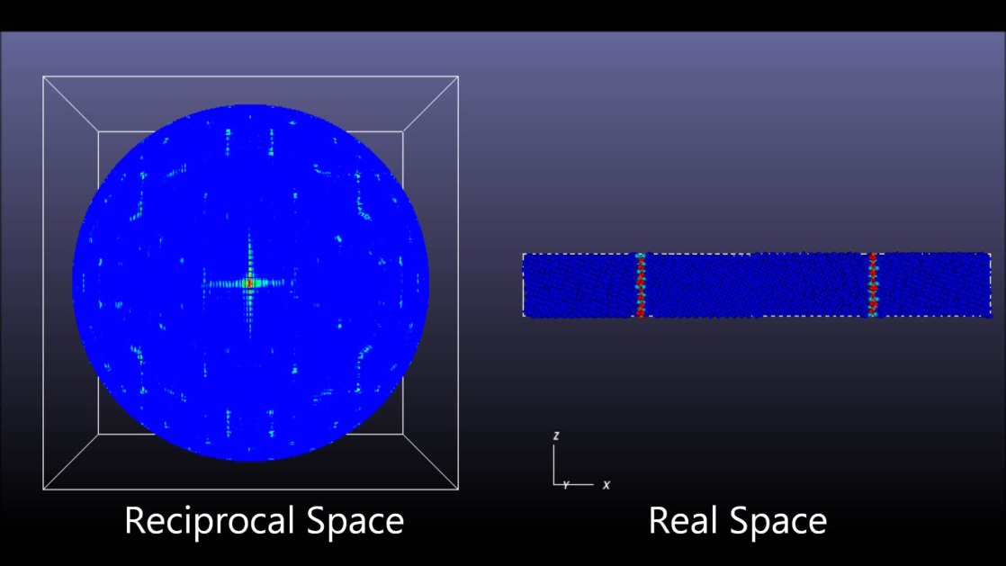
3D Diffraction Data
Example 3D diffraction data taken from Ni tilt grain boundary.
How to visualize 3D diffraction data to represent experimental techniques and make unique insights?

Slide 10
Analysis and Visualization
Diffraction Theory
Diffraction conditions satisfied when a reciprocal lattice node is located on the surface of Ewald’s sphere
X-Ray Powder diffraction patterns
All orientations of the crystal equally possible
Intensity data are binned corresponding to their diffraction angle calculated using Bragg’s law:
Concentric spherical shell bounding angles
Electron diffraction patterns
Radius of Ewald sphere much larger
Diffraction conditions intersect a near planar slice of reciprocal space lattice
X-Ray Diffraction
180°
b2
150°
310
120°
90°
1/λ
60°
30°
0°
100
origin
100
300
b3
origin
b1
b1
Electron Diffraction
1/λ
b2
310
origin
100
300
b3
b1

Slide 11
Check – Al Twist GBs
Virtual SAED patterns clearly identify misorientation in Al {111} twist GBs.
Secondary peaks emerge due to screw dislocation network.
Aluminum Twist Grain Boundaries

Slide 12

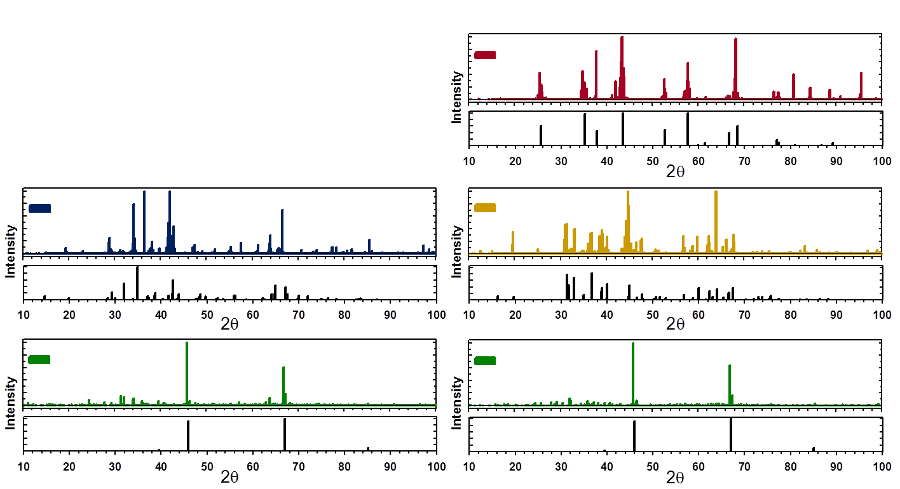
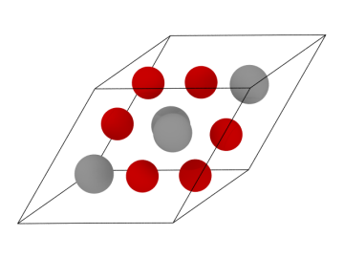

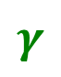



Bulk Alumina
Virtual x-ray diffraction patterns can successfully differentiate alumina polymorphs.
Virtual XRD patterns can be compared directly to experiments to validate the fidelity of the potential – ReaxFF.
Al₂O₃ Polymorphs
X-ray Diffraction
κ
$$α$$
$$κ$$
α
γ
Intensity
Intensity
Ishizawa (1979)
Ollivier (1997)
θ
Intensity
$$θ$$
Intensity
$$γ$$
Husson (1996)
Verwey (1935)
A generic tool for structural identification in simulations of complex materials.
Coupled with optimization routine, can become a route to provide atomic resolution of experimental diffraction patterns – including defects.

Slide 13
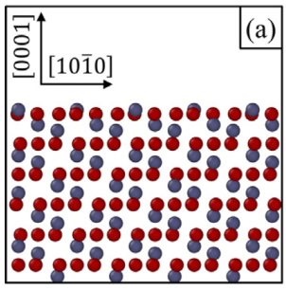
Alumina Surfaces
α-Al₂O₃ (0001) Surface
Virtual SAED patterns can verify the correct orientation of surface simulations.
Virtual SAED identify substantial surface reconstructions still have underlying structure.
Providing atomic detail to smearing of diffraction peaks can help associate to specific strain field.
Tracking ‘motion’ of peaks to identify phase transformation mechanisms.
θ-Al₂O₃ (110) Surface

Slide 14
Alumina Interfaces
Virtual SAED patterns help identify misorientation in Al₂O₃ GB simulations.
Simulated patterns are matched to experimental (when available) to provide further validation of the structure.
α-Al₂O₃ Basal Twin Boundary
Virtual SAED patterns aided the construction of complex interfaces.
Optimal orientation relationship evaluated by overlapping diffraction peaks.

Slide 15
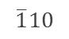
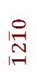
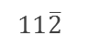
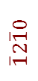
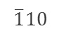
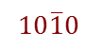
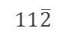
α-Al₂O₃ (0001) / Al (111) Orientation Relationship
Modeled interface SAED pattern by overlapping SAEDs from each grain.
Lower interface energy found at maximum overlapping diffraction peaks.
α-Al₂O₃ (0001)
Al (111)
Interface
$$\overline{1}10$$
$$\overline{1}10$$
$$\overline{1}2\overline{1}0$$
$$11\overline{2}$$
$$\overline{1}2\overline{1}0$$
$$11\overline{2}$$
$$10\overline{1}0$$
$$10\overline{1}0$$

Slide 16
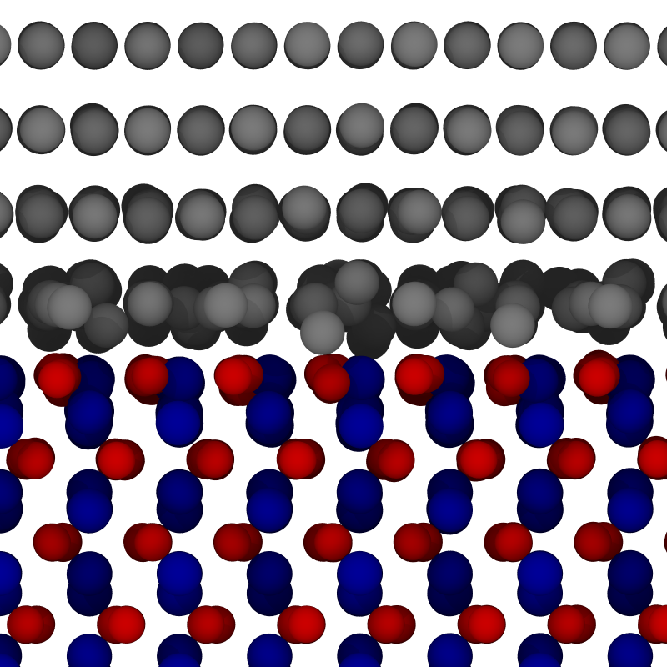
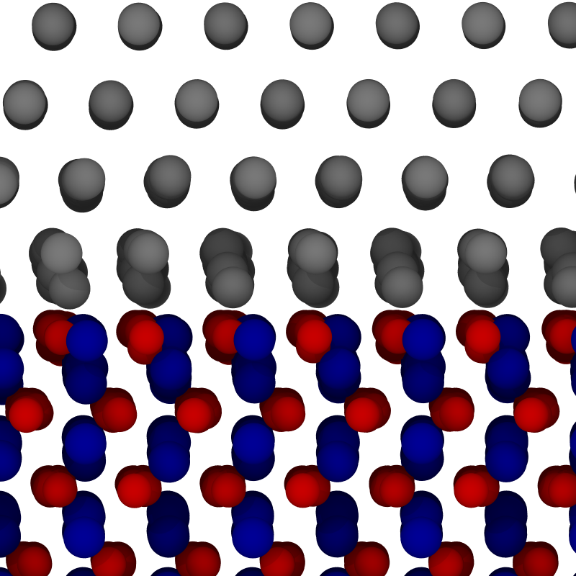
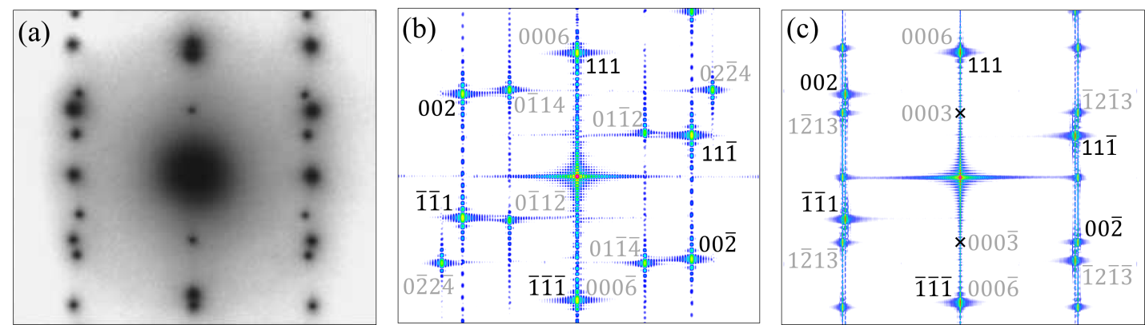
α-Al₂O₃ (0001) / Al (111)
Initial Orientation
Optimized Orientation
$$111$$
Work of adhesion using ReaxFF agree with DFT prediction
Initial - 0.40 J/m²
Optimized - 0.82 J/m²
DFT: 1.06 J/m² Siegel (2002)
Optimized orientation SAED agrees with experimental.
$$111$$
$$\overline{1}10$$
$$11\overline{2}$$
$$0001$$
$$0001$$
z
$$\overline{1}2\overline{1}0$$
z
x
$$\overline{1}2\overline{1}0$$
x
Medlin (1997)

Slide 17
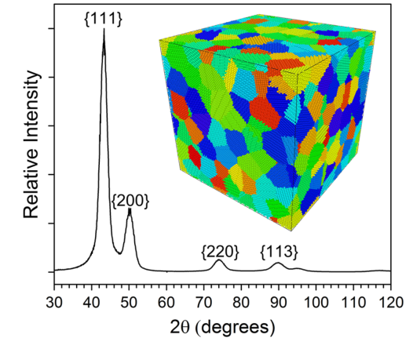
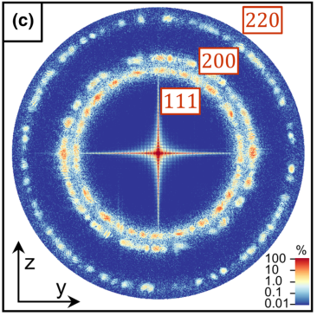
Wrap Up
Conclusions
Implementation of XRD and SAED virtual diffraction methods open new routes for greater coupling between experiments and simulations.
Designed to be sufficiently generic for any material system and is adaptable to multimillion atom simulations.
Future Outlooks
Nanocrystalline Metals
Using virtual diffraction to identify mechanisms of phase transformation and grain growth.
Investigating the coupling between simulation length scales using peak broadening.
Thank You

